Slide 1

Small and Medium Range Wireless Electronic Notice Board using Bluetooth and ZigBee
By
DHARMENDRA KUMAR SHARMA
VINEET TIWARI , KRISHNA KUMAR, B. A. BOTRE, S.A. AKBAR
CSIR-Central Electronics Engineering Research Institute, Pilani -333031
pvlr@ceeri.ernet.in
Presented at
12th IEEE India International Conference INDICON 2015, E3-C3 17-20 December, Jamia Milia Islamia, New Delhi, India
1

Slide 2
Contents
Introduction
System Development
Software Development
Flow Chart For Microcontroller Code Flow
Flow Chart For Android Application Development
Terminal software for ZigBee Module
Conclusion
Results
Acknowledgement
References

Slide 3
Introduction
Paper consumption is the superlative reason for forest degradation and notice is an indispensable requirement for public places, organization to get connect/communicate with people in one way or both
A low cost, handheld, wireless electronic notice board by using Atmel’s ATmega32 microcontroller and different wireless technologies (Bluetooth and ZigBee)
The performance analysis –
Range, BER (bit error rate)
RSSI (Received signal strength indicator)
signal attenuation and power consumption
Wireless e-notice board is a perfect replacement of paper notice board providing easy maintenance, portability and access

Slide 4
System Development
The system consists of both software and hardware
Software area includes the Bluetooth android application development and code algorithm for microcontroller to receive and display a notice on graphical liquid crystal display
The hardware area includes the development of receiver hardware using ATmega32 microcontroller and its configuration with both modules
The developed system reflects the minimum requirements to realize the wireless notice board. The system has the following sections –
Bluetooth Communication
Bluetooth Module and Connection
ZigBee
System Integration

Slide 5
Software Development
The microcontroller code
AVR studio 5.0 IDE
routines to send back the received data to the transmitter module so user could get an echo/ acknowledgement for the transmitted data at the transmission terminal ensuring the successful data transmission
The code flow chart describes the working of both transmitter and receiver section (microcontroller code flow)
Flow chart of Android application development presented for clear understanding of the entire system

Slide 6
Flow Chart For Microcontroller Code Flow

Slide 7
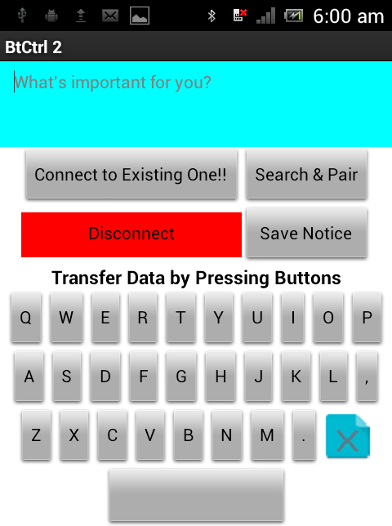
Flow Chart For Android Application Development
Android application snapshot

Slide 8
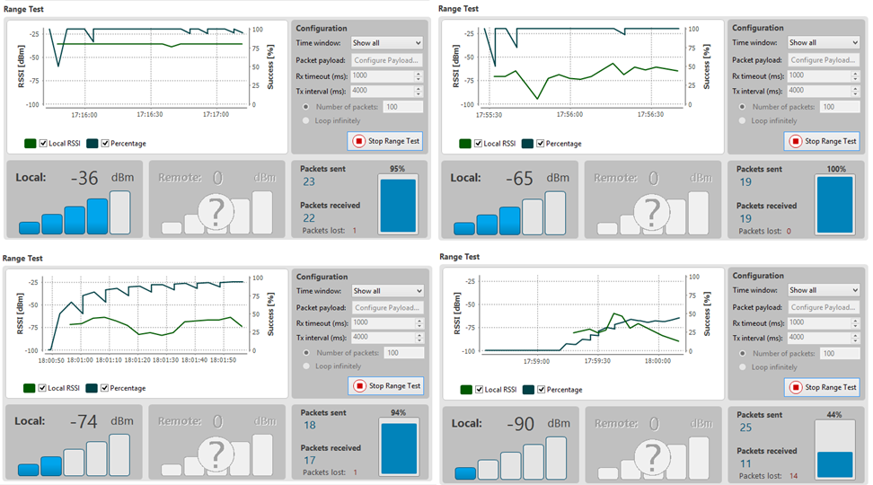
Terminal software for ZigBee Module
RSSI, data transmission success rate with packets lost using XCTU at indoor environment

Slide 9
Hardware Block Diagram

Slide 10
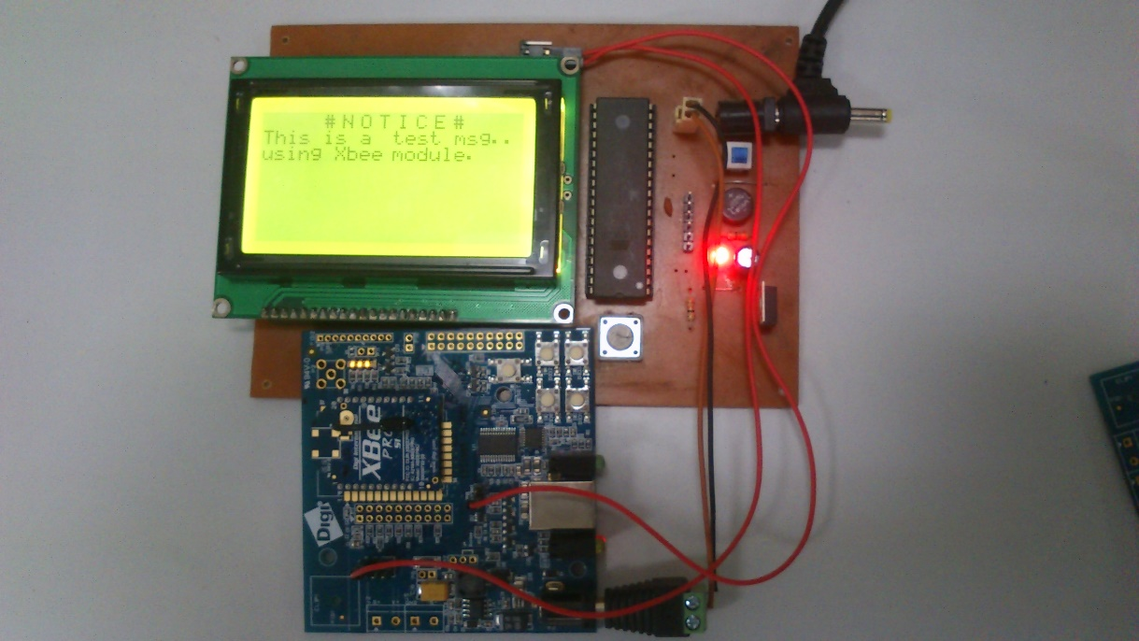
Developed System

Slide 11
Results
Transmission Range (m) | Packet Received (%) @ Outdoor | Received signal strength (RSSI), dBm | Packet Received (%) @ Indoor | Received signal strength (RSSI), dBm
10 | 100 | -65 | 100 | -75
30 | 100 | -79 | 100 | -79
50 | 100 | -81 | 100 | -80
70 | 100 | -80 | 80 | -85
90 | 100 | -83 | 100 | -87
110 | 100 | -87 | 65 | -90
130 | 100 | -90 | 32 | -94
150 | 55 | -89 | 12 | -93
170 | 31 | -93 | 4 | -95
190 | 20 | -92 | - | -
210 | 19 | -93 | - | -
230 | 8 | -94 | - | -
250 | 3 | -96 | - | -
ZigBee range results

Slide 12
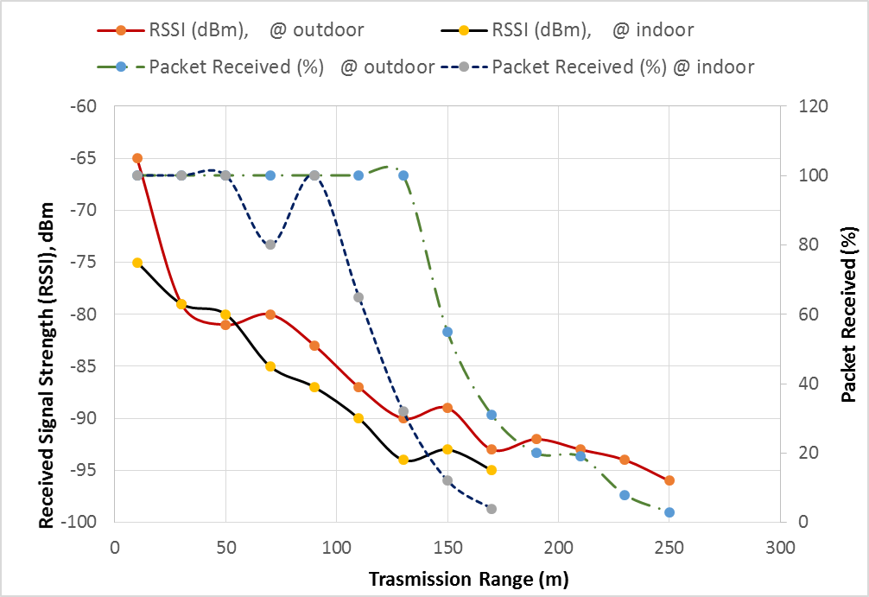
Continue…
ZigBee range: Indoor and Outdoor

Slide 13
Conclusion and Future work
In this project a low cost, office/ industry usable, portable wireless notice board has been successfully developed.
The graphical LCD displays transmitted character and its functionality satisfies all definitions of notice board.
The developed notice board is a prototype, made considering minimum system requirement and this work have interminable possibilities for further up-gradation like using larger colored display with a long range Zig-Bee wireless node connection to enhance the range of operation.

Slide 14
Acknowledgement
The work presented in this paper is done in Electronic Control system Lab at CSIR-Central Electronic Engineering Research Institute. The authors extend their gratitude to the director CSIR-CEERI, for providing healthy atmosphere of work. Also, we would like to thank the working members of our lab for their constant support

Slide 15
References
[1] McDermott-Wells, P., "What is Bluetooth?," in Potentials, IEEE , vol.23, no.5, pp.33-35, Dec. 2004-Jan. 2005, doi: 10.1109/MP.2005.1368913
[2] Digi International, "RF Feature Articles," 25 2 2015. [Online]. Available: http://www.digi.com/technology/rf-articles/rf-basics.
[3] Sparkfun Electronics, "Exploring XBees and XCTU," 25 2 2015. [Online]. Available: https://learn.sparkfun.com/tutorials/exploring-xbees-and-xctu.
[4] Zafft, A.; Agu, E., "Malicious WiFi networks: A first look," in Local Computer Networks Workshops (LCN Workshops), 2012 IEEE 37th Conference on , vol., no., pp.1038-1043, 22-25 Oct. 2012
[5] developershome, "1. Introduction to SMS Messaging," 25 2 2015. [Online]. Available: http://www.developershome.com/sms/smsIntro.asp.

Slide 16
Continue…
[6] M. R. Bhoyar, S. Chavhan, V. Jaiswal, "Secure Method of Updating Digital Notice Board Through Sms With Pc Monitoring System," IOSR Journal of Computer Science (IOSR-JCE), pp. 24-29, 2014.
[7] Weihua Pan; Fucai Luo; Lei Xu, "Research and design of chatting room system based on Android Bluetooth," in Consumer Electronics, Communications and Networks (CECNet), 2012 2nd International Conference on , vol., no., pp.3390-3393, 21-23 April 2012
[8] Jianping Cai; Jianzhong Wu; Minghui Wu; Meimei Huo, "A bluetooth toy car control realization by android equipment," in Transportation, Mechanical, and Electrical Engineering (TMEE), 2011 Conference on , vol., no., pp.2429-2432, 16-18 Dec. 2011
[9] Robokits India, "BLUETOOTH UART MODULE," 25 2 2015. [Online]. Available: http://robokits.co.in/wireless-solutions/bluetooth-uart-module.
[10] Digi Internatonal, " XBIB-U-DEV," 25 2 2015. [Online]. Available: http://www.digikey.com/product-detail/en/XBIB-U-DEV/602-1407-ND/3482650.

Slide 17
Thankyou

Slide 18
Queries

